Slide 1
Beyond the pie: Communicating with objects using menu based natural Language interfaces
Tanmaya Kumar and Craig Thompson

Slide 2
Now …
Objects around us are not (yet) self-unaware and do not know their own identity, type, or owner
Humans communicate with humans but cannot talk to things
Humans cannot discover a new command language every time they meet a new object
Researchers have not overcome the habitability issue
Overshooting: User says something to system that it cannot understand.
Undershooting: User fails to use commands the system does understand.
In the future …
Any human can communicate with any object or collection of objects using object-specific grammars.
Objects may be remote
Grammars will be uniform – a thermostat grammar can communicate uniformly to thermostats from all manufacturers.
Develop ideas in virtual worlds and translate to smart phones and communicating with real world objects identified with technologies like RFID.

Slide 3
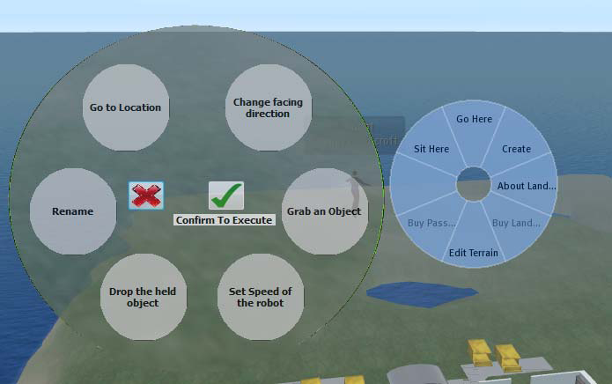
PIE 2.0
SL PIE menu (right) is static, insensitive to object type.
Our PIE 2.0 menu (right, robot example ) is dynamic, cascading, and type aware.

Slide 4
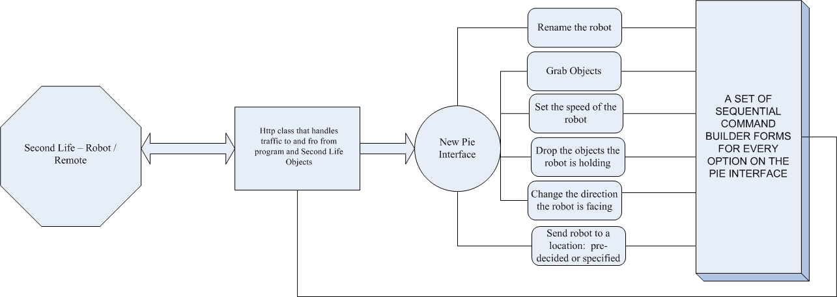
Robot command language grammar

Slide 5
Next Steps
The recently released viewer 2.0 no longer uses a PIE menu. Now it supports a drop down box but with the same static options as before (so only the GUI has changed shape). We will shift to that form of displaying our PIE but continue to dynamically download object-sensitive menus.
So far, we have only developed a grammar for robots – we expect to generalize so grammars for objects are stored in an ontology service (grammar cloud) with an understanding of inheritance and additional location qualifiers
Lights on the table turn on – should turn on only the lights on the table.

